Slide 1
24MAT120
S2 P and M

Slide 2
Line Integrals
In double integrals we add over a region. What if we want to add along a curve?
Examples:
mass of a wire
work done along a path
This leads to line integrals.

Slide 3
Two Types of Line Integrals
Scalar Line Integral
Vector line Integral

Slide 4
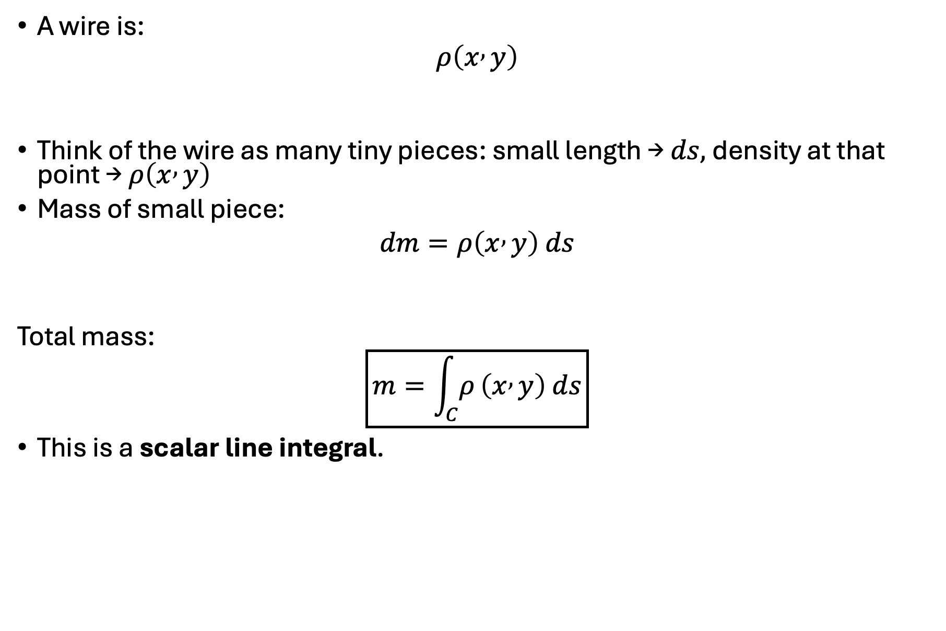
A wire is:
$$ρ\left(x , y\right)$$
Think of the wire as many tiny pieces: small length → $ds,$density at that point → $ρ\left(x , y\right)$
Mass of small piece:
$$dm=ρ\left(x , y\right) ds$$
Total mass:
$$\boxed{m=\int_{C}{ρ}\left(x , y\right) ds}$$
This is a scalar line integral.

Slide 5
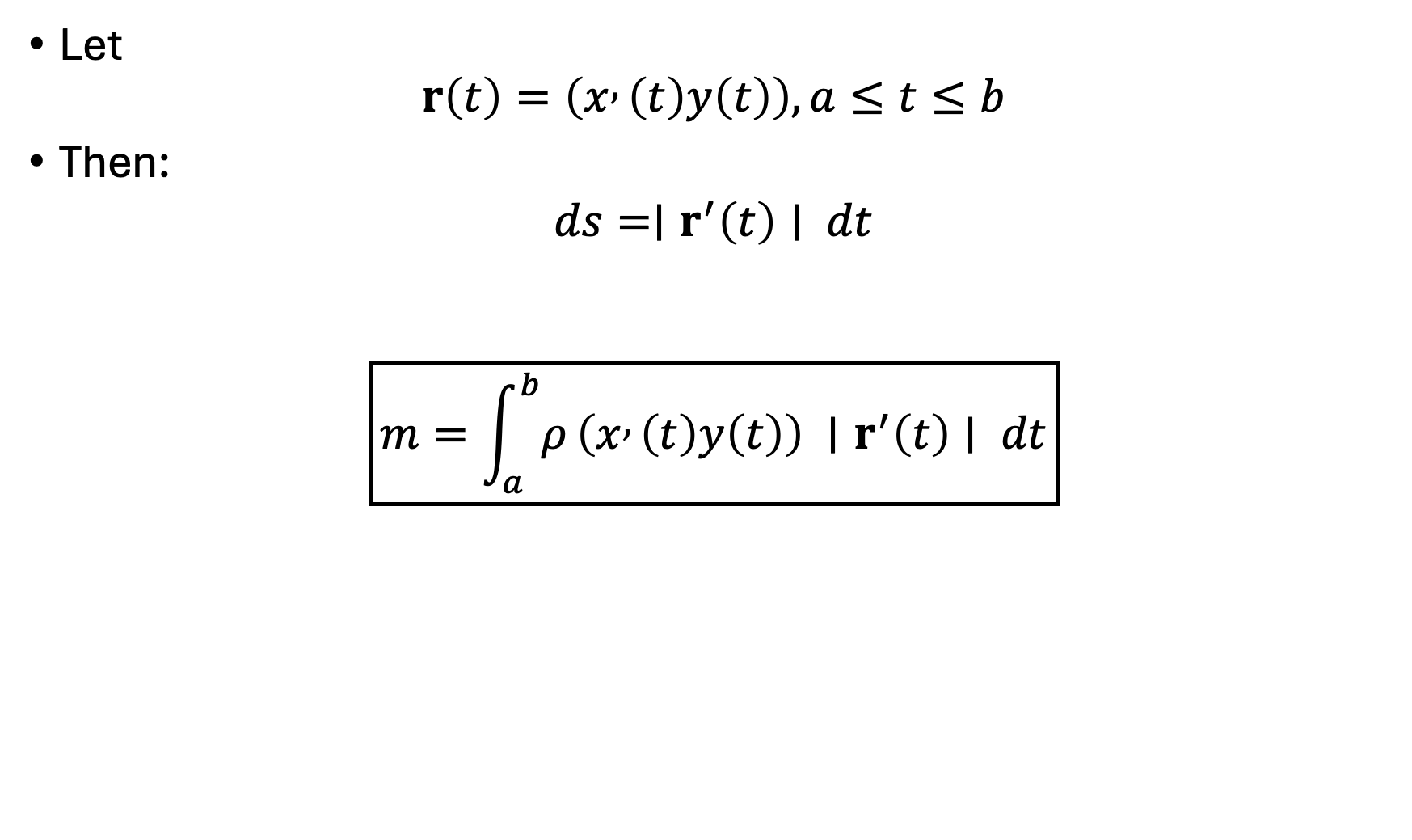
Let
$$r\left(t\right)=\left(x , \left(t\right)y\left(t\right)\right), a≤t≤b$$
Then:
$$ds=∣r^{′}\left(t\right)∣ dt$$
$$\boxed{m=\int_{a}^{b}{ρ}\left(x , \left(t\right)y\left(t\right)\right) ∣r^{′}\left(t\right)∣ dt}$$

Slide 6
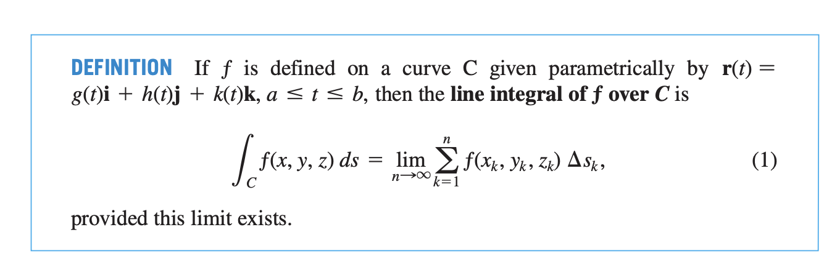

Slide 7
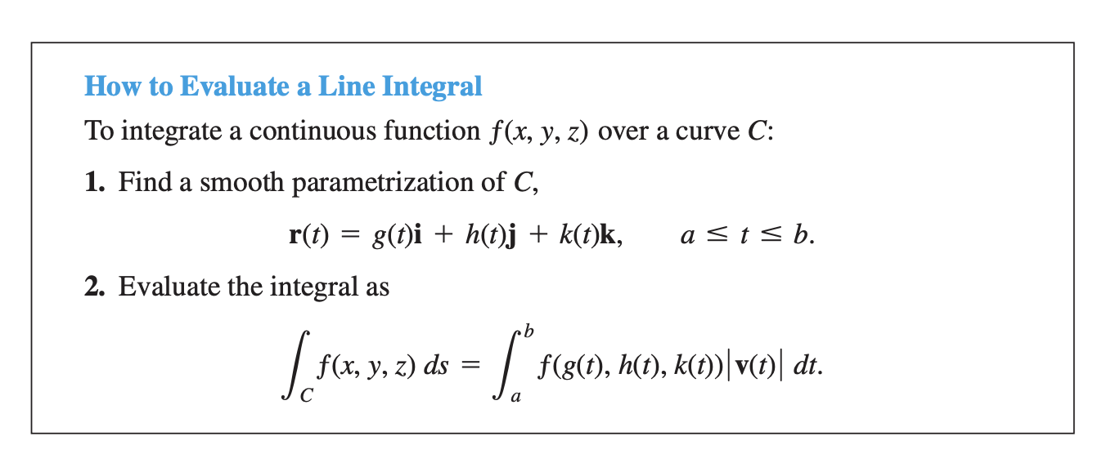

Slide 8


Slide 9
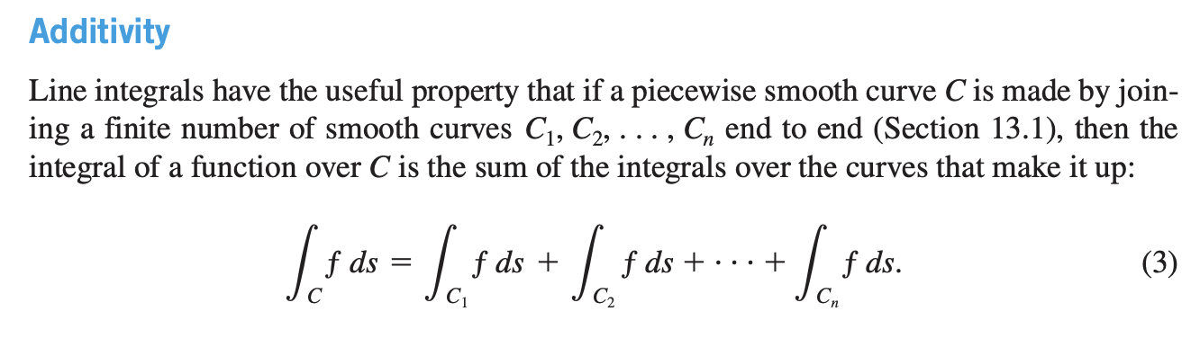

Slide 10
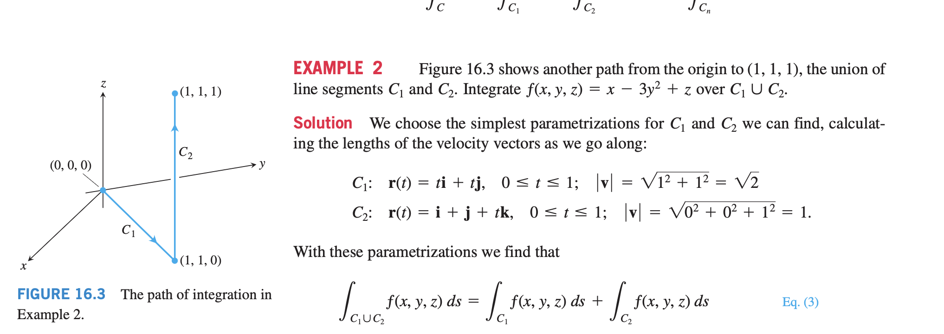

Slide 11
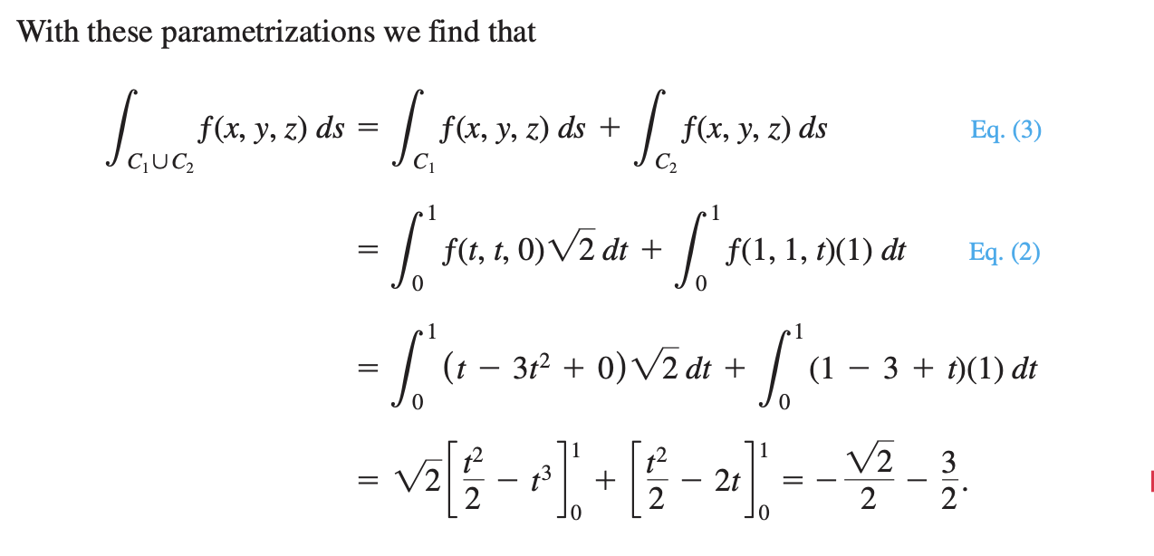

Slide 12
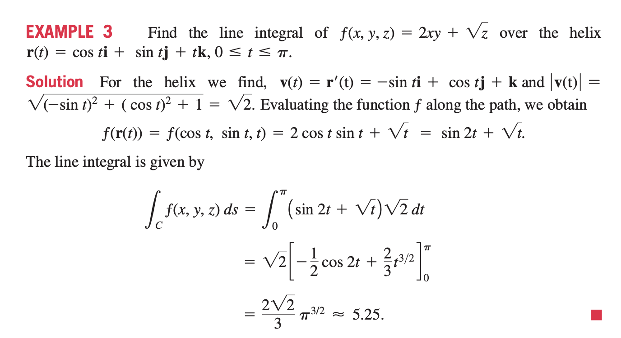

Slide 13
